Slide 1
Theme, Goals & Plans
Hiro Tanaka
AP ASP AREA (2018-2020)

Slide 2
Asia Pacific Area

Slide 3
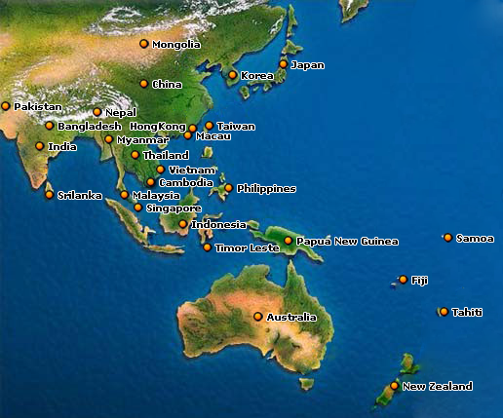


Slide 4
Australia | Nepal
Bangladesh | New Zealand
Cambodia | Pakistan
China | Philippines
Fiji | Samoa
Hong Kong | Singapore
Indonesia | Sri Lanka
Japan | Tahiti
Macau | Taiwan
Malaysia | Thailand
Mongolia | Tiomor-Leste
Myanmar | Vietnam

Slide 5
Australia | Nepal
Bangladesh | New Zealand
Cambodia | Pakistan
China | Philippines
Fiji | Samoa
Hong Kong | Singapore
Indonesia | Sri Lanka
Japan | Tahiti
Macau | Taiwan
Malaysia | Thailand
Mongolia | Tiomor-Leste
Myanmar | Vietnam

Slide 6
Australia | Nepal
Bangladesh | New Zealand
Cambodia | Pakistan
China | Philippines
Fiji | Samoa
Hong Kong | Singapore
Indonesia | Sri Lanka
Japan | Tahiti
Macau | Taiwan
Malaysia | Thailand
Mongolia | Tiomor-Leste
Myanmar | Vietnam

Slide 7
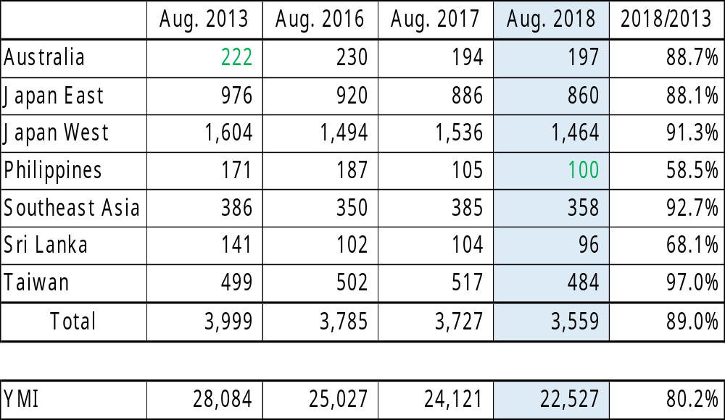

Slide 8
YMI MEMBERSHIP (Aug. 2018)

Slide 9
ASP AREA MEMBERSHIP (Aug. 2018)

Slide 10
Purpose of ASP Area
To support each Region within ASP Area

Slide 11
Goals of ASP Area
Each Region to become more active
Each Region to provide more and better services to YMCA and local communities

Slide 12
THEME
ACTION!

Slide 13
Action for ・・・

Slide 14
BF
IBC
Aging
Extension
ADF
EF
YIA
TOF
Constitution
YMCA Service
Communication
ASF
YES
Membership
Area
Bulletin
Portalbuzz
BF
CS
Green Activity
RBM
Area
Convention
LT
Zone Concept
STEP
Menettes
Responsiveness
Area Website
YEEP

Slide 15
PDCA
PLAN
DO
CHECK
ACTION

Slide 16
PRIORITIZATION

Slide 17
OPPORTUNITY
THREAT
STRENGTH
WEAKNESS

Slide 18
ASIA PACIFIC AREA
OPPORTUNITY
THREAT
Economic growth of Asia
‘Towards 2022 and Beyond’
Diversity of countries
Zone Concept
Aging issue
Changes in life style
Many Natural disasters
Diversity of languages
STRENGTH
WEAKNESS
Merger of Asia Area & SOP Area
Experienced leaders
Existence of Area Office
Young ICM
Good relationship with YMCA
Good CS activities
Decrease in membership
Small Regions
Some Isolated Clubs
Lack of new/young leaders
Difficulty in communication

Slide 19
XXXXX REGION
OPPORTUNITY
THREAT
STRENGTH
WEAKNESS

Slide 20
Community Service
YMCA Service
  Sharing good examples of such service programs
  Introduction of an award system for motivation
  Promotion of signing a Principles of Partnership between the Region and the YMCA (s) in your Region.

Slide 21
Principles of Partnership
between
ASIA & PACIFIC ALLIANCE OF YMCAs
and
Y’s Men International – ASIA Area
WHEREAS the Asia and Pacific Alliance of YMCAs and Y’s Men International, Asia Area base their actions and services on a Christian purpose and
WHEREAS these two Area Movements are instruments of national awareness and have responsibilities for stimulation and co-ordination of their respective organisations and
WHEREAS these two Area Movements are and should remain independent,
IT IS CONSEQUENTLY ACKNOWLEDGED that the Asia and Pacific Alliance of YMCAs and Y’s Men International, Asia Area are desirous of working towards new dimensions of partnership that will contribute to individual and collective growth and service at local, regional and area and national levels.
THEREFORE, the Asia and Pacific Alliance of YMCAs and Y’s Men International, Asia Area adopt the following Principles of Partnership:
It is reaffirmed that the two organisations have a Christian basis from which originates the purpose of serving people, and that this service is carried out for all people without discrimination.
It is accepted that collaboration and support first require the identification of common objectives, and then selection of specific tasks, programmes and projects.
It is recognised that in this process both organisations are at the same level of responsibility, and it is consequently expected that both should participate in the initial thinking, the development of plans, the funding, the implementation and the evaluation.
It is expected that from whatever is carried out in partnership, both organisations should give and receive benefit.
It is expected that both organisations should be open to the participation and involvement of the other at local, regional, area and national levels, thus strengthening the relationship and co-operation.
It is recognised that the effectiveness of the partnership depends upon mutual trust and support, that the potential benefits are many and that both organisations should assist each other’s development in mutually acceptable ways. This should be reflected, in particular, by evidence of greater YMCA support for extension of Y’s Men International and increase of its membership, which in turn implies recognition of the increasing potential of Y’s Men action as a service club for the YMCA.
IN WITNESS WHEROF the Asia & Pacific Alliance of YMCAs and Y’s Men International, Asia Area, by their proper officers duly authorised, hereby affix their signatures on the Seventh Day of March in the Year 2014.
On behalf of On behalf of
Asia & Pacific Alliance of YMCAs Y’s Men International, Asia Area
________________ ________________ ___________________________
Yau Chung Wan Kohei Yamada Yaz Okano
President General Secretary Area President

Slide 22
EMC
  Support extension in the new countries
  Support isolated countries and clubs
  Effective use of the YES Fund and ADF

Slide 23
Communication
  Revival and utilization of the Area Website
    Frequent update of information by the AEOs, RDs and ASDs
    Utilization of the Bulletin Board on the Website for such information as formation of a new IBC relationship, invitations to events, etc.
  Publication of the Area Bulletin
  Timely dissemination of messages by the AP and all ASDs
  Improvement of responsiveness from each Region including replies, answers, remittance of Area Dues, etc.
  Quick assistance in times of natural disasters

Slide 24
Contributions
  All the Regions are requested to contribute all the projects(i.e. ASF, BF, EF, RBM, TOF, YES）
  Encourage the ASD in charge of each project to have each Region achieve the goal of contribution

Slide 25
Portalbuzz
  To start the Portalbuzz in the Region where it is not in use yet.
    Japan West
    Philippines
    SEA

Slide 26
LTOD
  Assist the Region in need of support and cooperation
  Promote utilization of GOLD 2.0
  Strengthen the RDE training

Slide 27
Youth Activities
  Promote STEP and YEEP
  Support a new Youth Club establishment
  Encourage participation in the AYC 2019

Slide 28
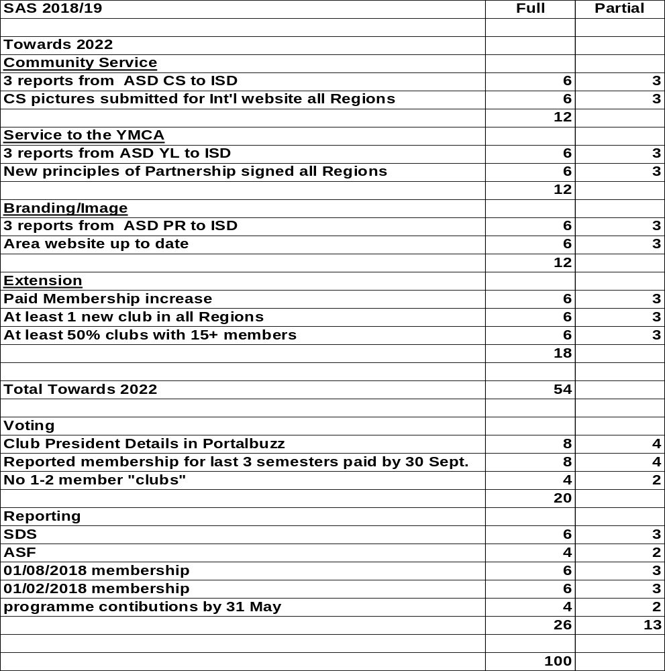
SAS Criteria for 2018-2019

Slide 29

2019
28th Asia Pacific Area
Convention

Slide 30
On:
19 (Fri)- 21(Sun) July, 2019
At:
Sendai International Center
Sendai, JAPAN

Slide 31
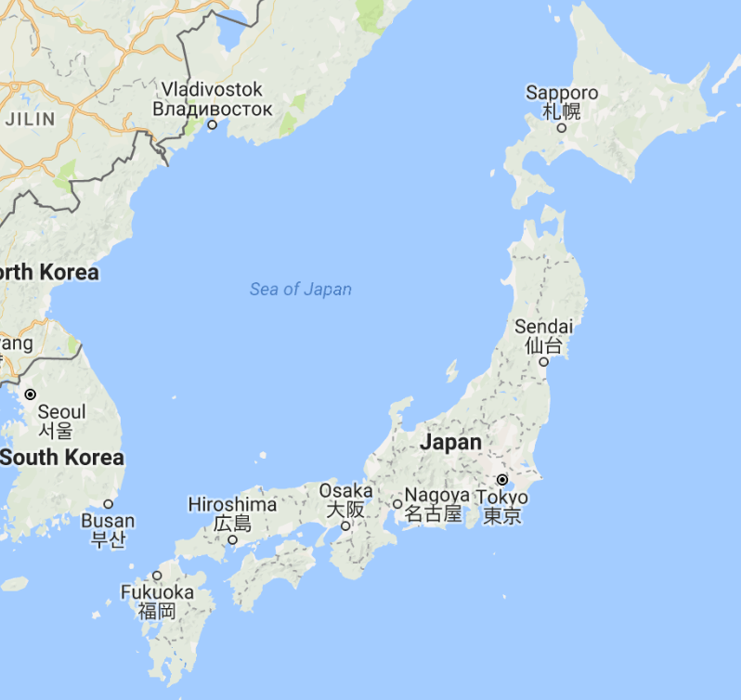
Sendai

Slide 32
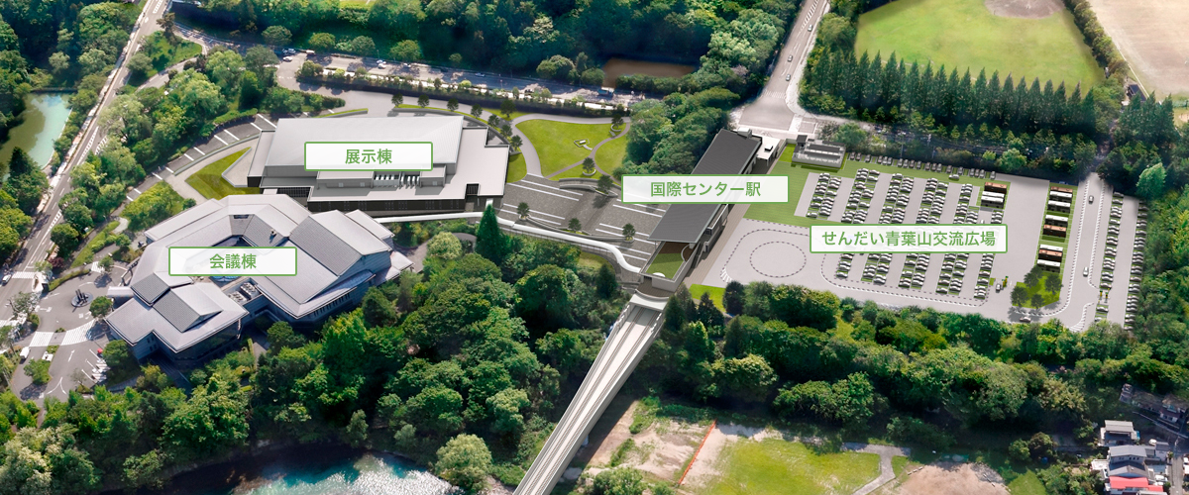
Sendai International Center
Exhibition Building
Subway Station
Conference Building

Slide 33
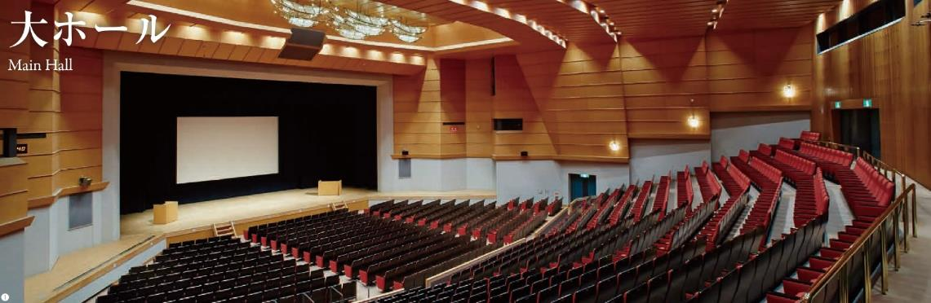
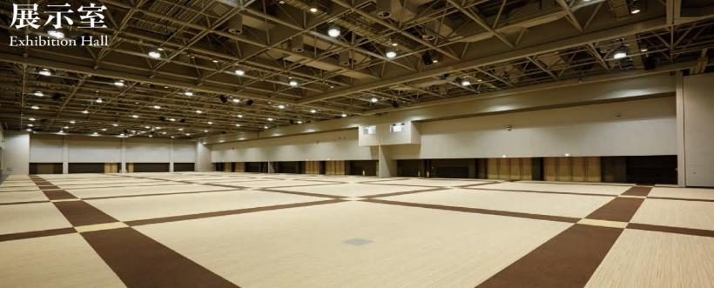
Main Hall Capacity:1,000 persons
Exhibition Hall Capacity: 1,000 persons

Slide 34
2019
Asia Pacific Area
Youth Convocation

Slide 35
On:
17 (Wed)- 21(Sun) July, 2019
At:
Kibotcha, Higashi Matsushima

Slide 36
SLOGAN
With Pride and Pleasure

Slide 37
With Pride and Pleasure ,
We ・・・・・

Slide 38
BOSS ?
LEADER?

Slide 39
BOSS | LEADER
CONTROLS | COACHES
USES MEMBER | DEVELOPS MEMBER
SAYS ‘I’ | SAYS ‘WE’
SAYS ‘GO’ | SAYS ‘LET’S GO’
DEPENDS ON AUTHORITY | DEPENDS ON COOPERATION
JUDGE OTHERS | ACCEPT OTHERS
CREATES FEAR | CREATS CONFIDENCE
HAS A WIN-LOSE APPROACH | HAS A WIN-WIN APPROACH
BLAMES MEMBER | LOOKS FOR SOLUTION

Slide 40


