Slide 1

Challenges, Goals and Priorities
Y’s Men International
Y Service Clubs International
Jennifer Jones IPE

Slide 2
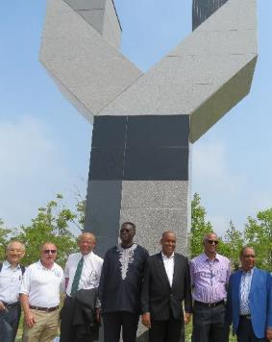
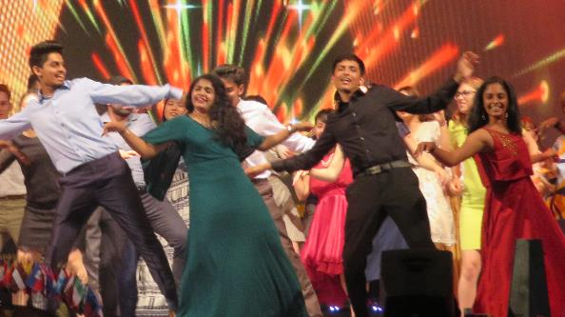
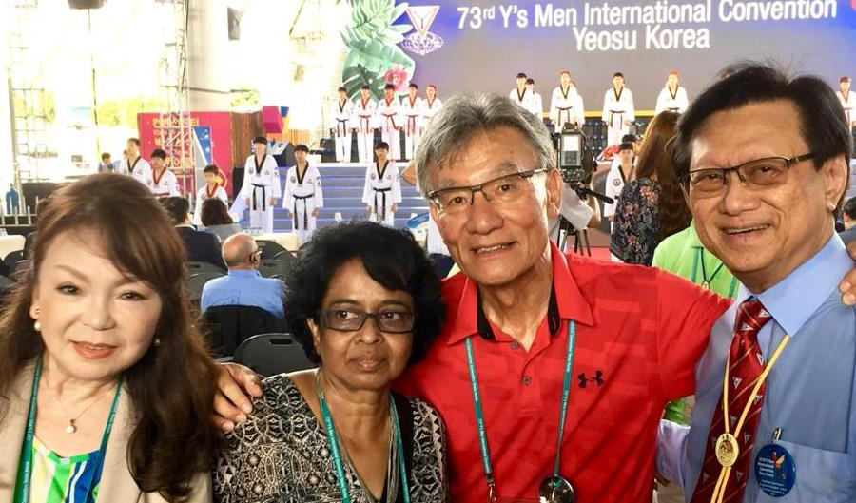
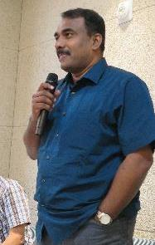
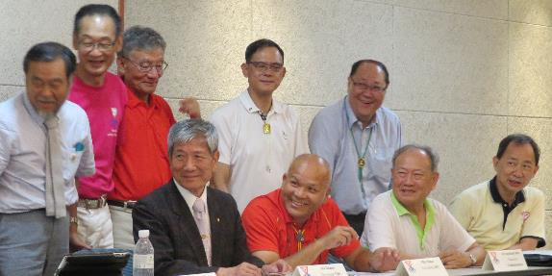
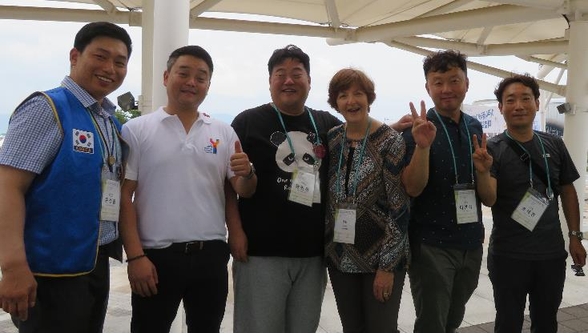
Who are we?

Slide 3
We are a MOVEMENT of people who make differences in the lives of others by:
Serving the YMCA
Serving the community
Serving each other

Slide 4
What does YMI OFFER?
Fun!!
cultural awareness trips
International exposure
leadership development
value…
connections..
sense of purpose
Self-satisfaction and 100’s of friends

Slide 5
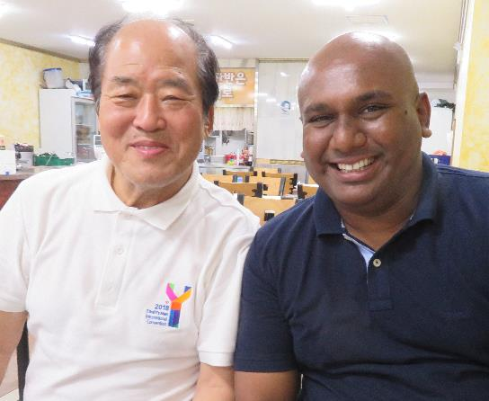
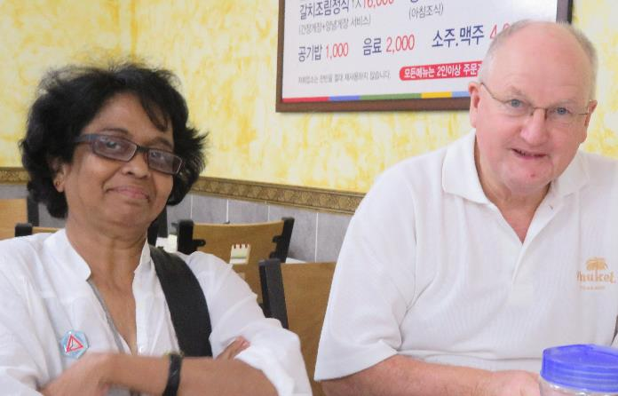
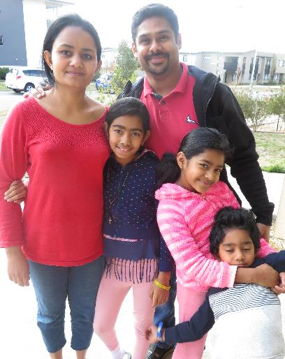
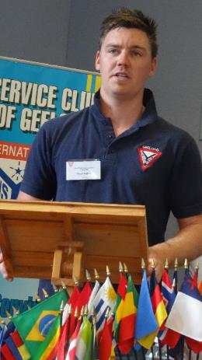
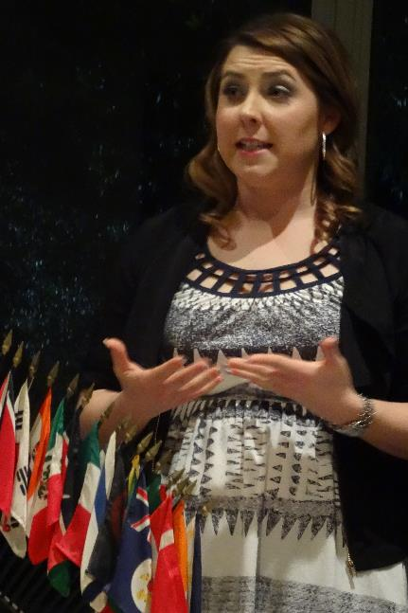
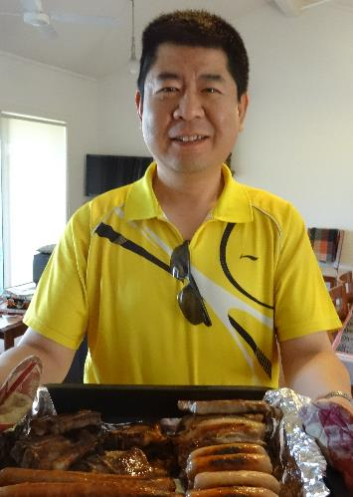
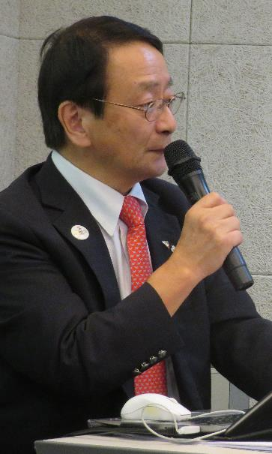
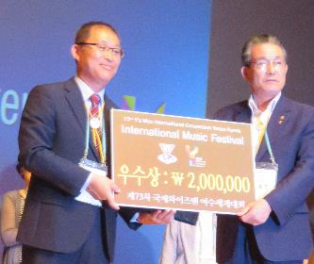
So who could be a leader?

Slide 6
Leaders should pursue significant goals. Do you as leaders want to:
Just survive?
Be successful?
Achieve significance?

Slide 7

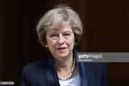
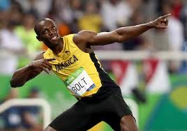
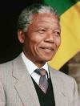

Survival, Success or Significance……

Slide 8
Goals
Without vision many people tend to fall or fade away
Someone said, “People who can see the invisible can do the impossible.”

Slide 9
1. MEMBERSHIP
What can WE do together to strengthen this important focus?
What LEGACY would we hope to pass on to others when we are no longer involved?

Slide 10
Towards 2022 and Beyond
Goal One
To extend YMI to at least 50,000 members based in 100 countries

Slide 11
What can YOU do?
Introduce friends to club life
Increase club numbers by 2-3 yearly
Start a new club nearby
Help your Region to start clubs in other countries

Slide 12
MEMBERSHIP | 1 August 2012 | 1 August 2017 |  | 1 February 2018
Areas | Paid Up | Clubs | Paid Up | Clubs | Paid Up
Africa | 254 | 18 | 129 | 18 | 141
Asia Pacific | 4,193 | 232 | 3,702 | 225 | 3,726
Canada/Caribbean | 518 | 26 | 429 | 26 | 429
Europe | 6,396 | 269 | 5,585 | 270 | 5,564
India | 9,670 | 469 | 7,545 | 517 | 8,173
Korea | 5,429 | 228 | 5,308 | 229 | 5,196
Latin America | 485 | 36 | 396 | 36 | 404
USA | 1,509 | 79 | 1,002 | 74 | 936
 | 28,354 |  | 24,096 |  | 24,520

Slide 13
So by what % should we grow annually?
10%
5%
20%
15%
More?

Slide 14
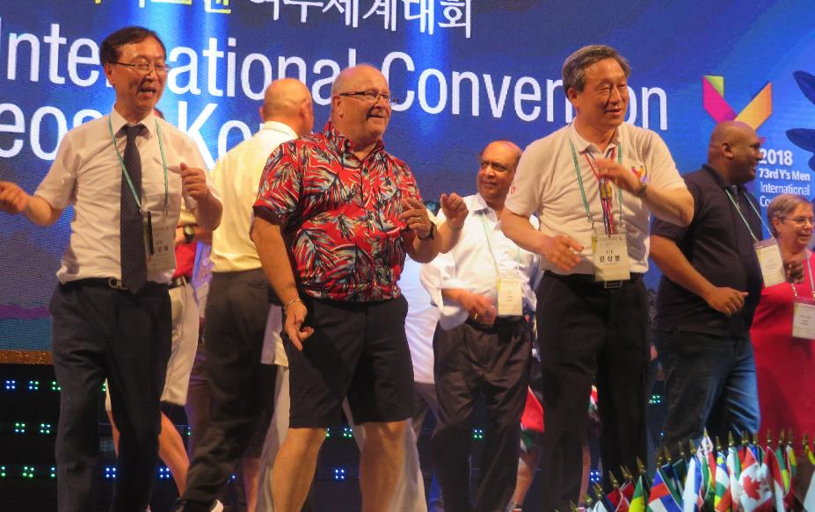
Could YOU
bring in one
new
member
over
the next
three
years?

Slide 15
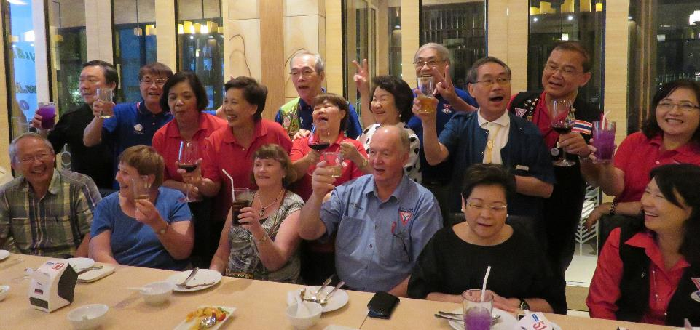

If you
could
that
means
the
membership would DOUBLE……

Slide 16
Towards 2022 and Beyond
Goal Two
To strengthen Y’s Men International (YMI) at the global level by:
offering relevant service to the YMCA and community;
enhancing our public image; and
improving our members’ perception of YMI and its mission

Slide 17
2. YMCA RELATIONSHIPS
Important and foundational, part of our DNA
New appointment of ISG Jose Varghese
YMI attendance at World YMCA 2018 and at YMCA 175 celebrations next year
YMCA attendance at IC 2018
Collaborative programs

Slide 18
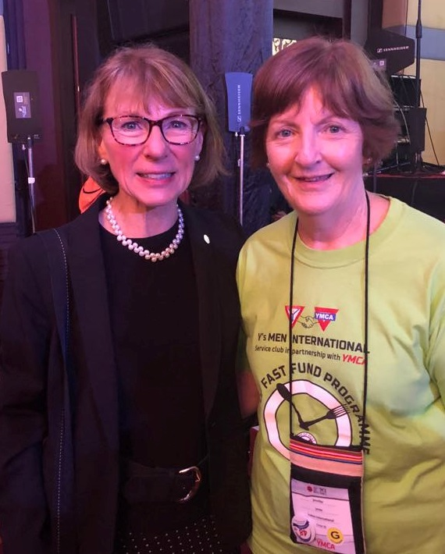
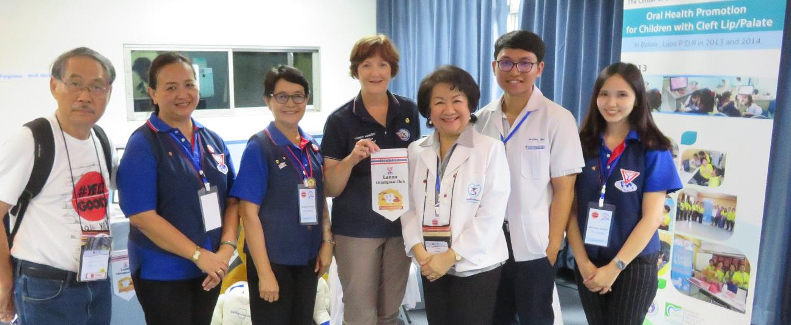
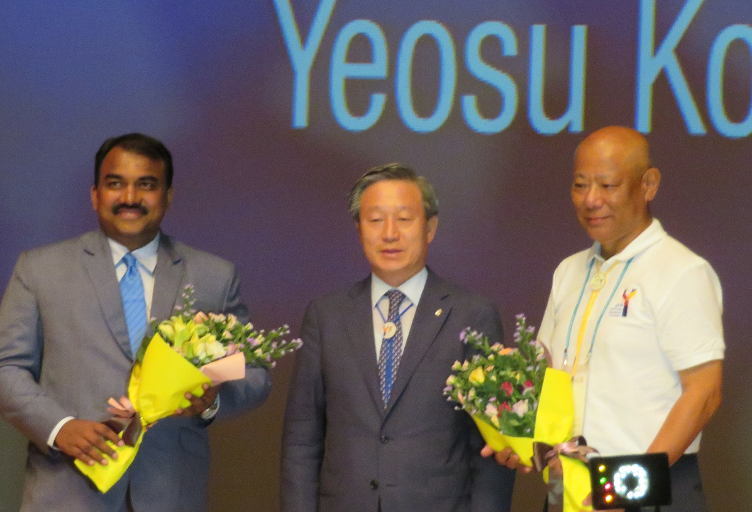
Some YMCA
Connections….

Slide 19
How can we help?
Support ASF
Give generously to TOF
Assist your local YMCA
Give financially to local work where possible
Join your local YMCA as a member

Slide 20
How generous have our AREAS been?

Slide 21
Program Contributions 2017-2018
AREA | ASF | BF | EF | TOF | RBM | TOTAL | %
Africa | 34 | 482 | 240 | 336 | 257 | 1,384 | 0.4
Asia Pac | 3,444 | 39,525 | 14,039 | 32,992 | 24,624 | 114,964 | 28.4
CAC | 711 | 6,207 | 360 | 3,782 | 2,205 | 13,265 | 3.3
Europe | 1,115 | 22,158 | 5,995 | 75,237 | 20,971 | 125,720 | 31.0
India | 404 | 2,055 | 30,193 | 8,040 | 6,529 | 47,615 | 11.7
Korea | 4,575 | 16,161 | 11,316 | 25,973 | 4,974 | 62,999 | 15.5
Latin Am | 335 | 2,473 | 986 | 2,905 | 1,187 | 8,558 | 2.1
USA | 216 | 6,761 | 3,453 | 14,011 | 6,521 | 30,973 | 7.6
Totals | 10,835 | 95,823 | 66,286 | 163,288 | 67,269 | 405,480
% IP Goals | 67% | 100% | 92% | 102% | 63% | 90%

Slide 22
What do you find interesting?
Are you content with these figures?
Which of these programs does your Area always support well?
Which ones could you realistically increase support for?

Slide 23
3. What else is happening?
Image and perception
Refocussing
Current successes
Creating an atmosphere of
ENTHUSIASM!!!

Slide 24
Every community deserves to have a Y’s club…….
Let’s help that become a reality!!

