Slide 1


Slide 2




The Y’s Men International 5th Korea Area Convention
Slogan
Let’s Do
Our Best
Now!!!
Theme
Y's Men changing
the world through
sharing and
volunteering

Slide 3
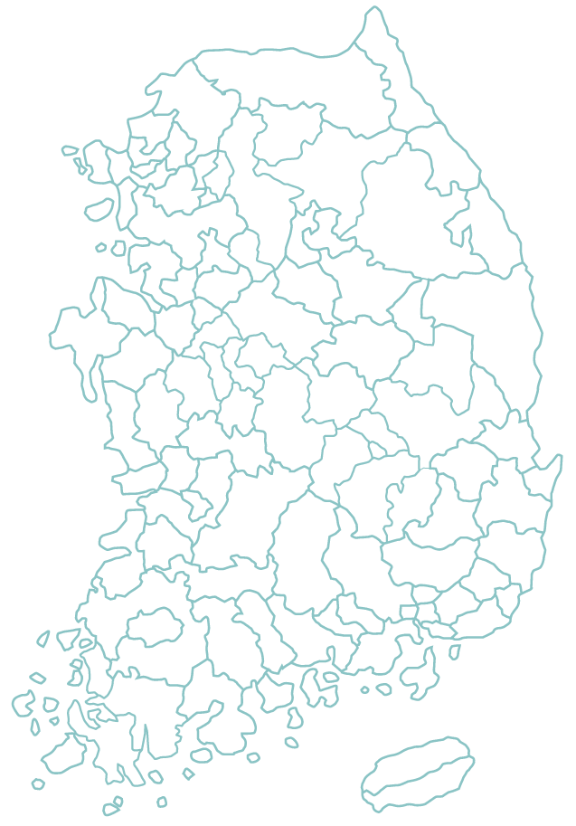


The Y’s Men International 5th Korea Area Convention
Location
The Y’s Men International
5th Korea Area Convention
Changwon

Slide 4
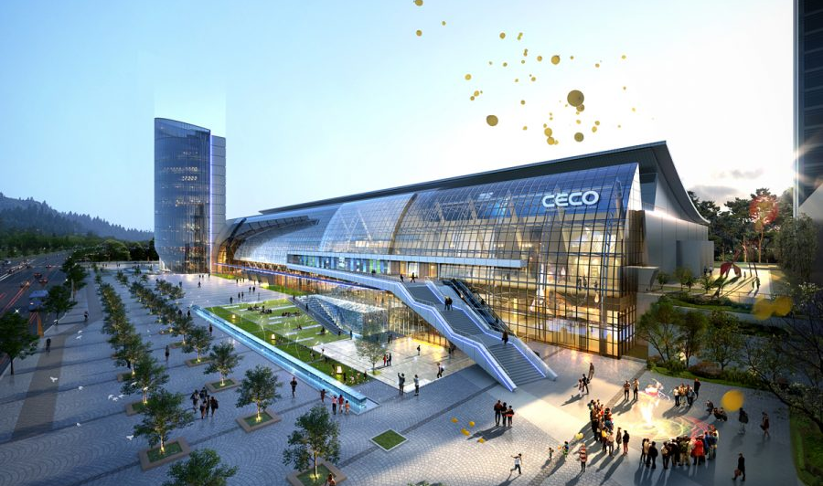
The Y’s Men International 5th Korea Area Convention
Location
• Date : August 23th to 24th 2019
• Venue : Changwon Exhibition Convention Center, Korea

Slide 5



The Y’s Men International 5th Korea Area Convention
창원컨벤션센터 CECO 교통
How to Come
Changwon Exhibition Convention Center(CECO) Transportation
Airplane
Incheon International Airport, Gimpo International Airport - Gimhae International Airport (1 hour)
Gimhae International Airport~ Changwon Convention Center (36km / 40 minutes take)
Train
Seoul Station to Changwon Station and Changwon Central Station (2 hours and 40 minutes)
Changwon Station, Changwon Central Station ~ Changwon Convention Center (5 to 6km) / Vehicles 10 to 15 minutes
Express bus
Seoul Express Bus Terminal~ Changwon Bus Terminal (4 hours)
Changwon Comprehensive Bus Terminal ~ Changwon Convention Center (2.5km / 5 minutes drive)

Slide 6
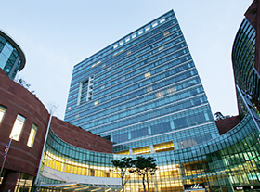
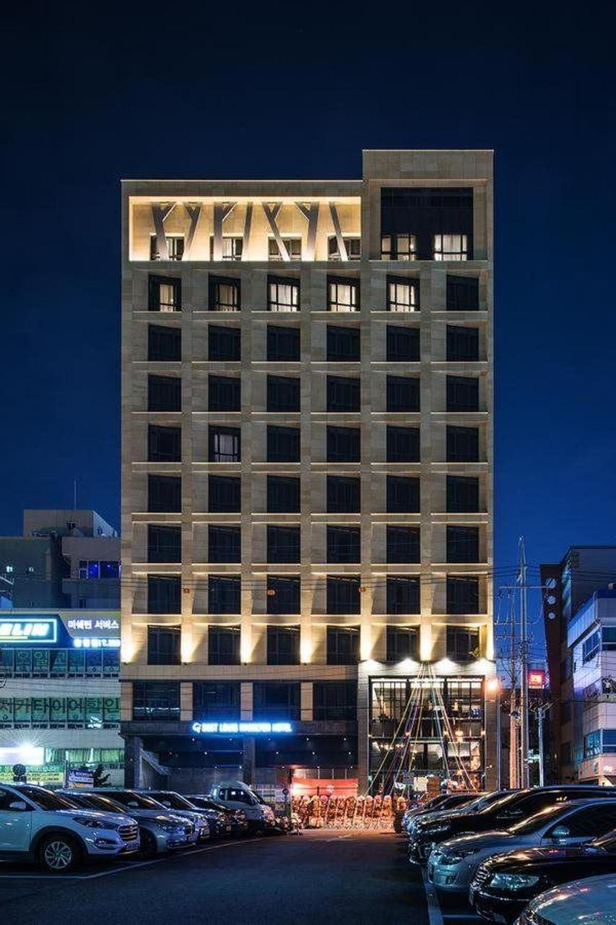
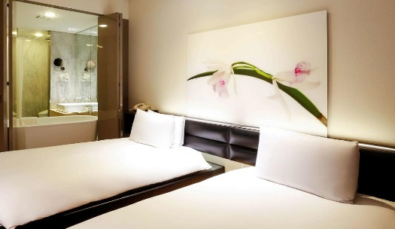
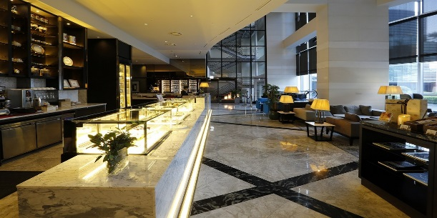
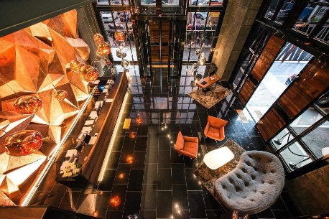
The Y’s Men International 5th Korea Area Convention
Accommodation

Slide 7
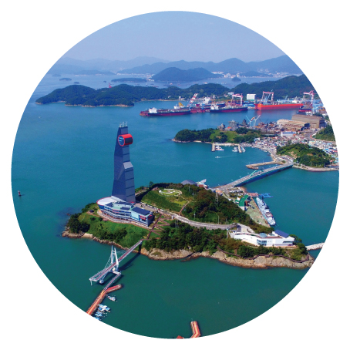
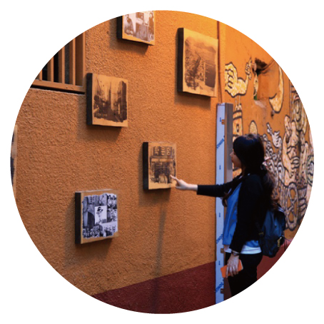

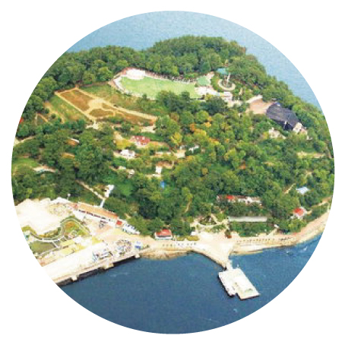

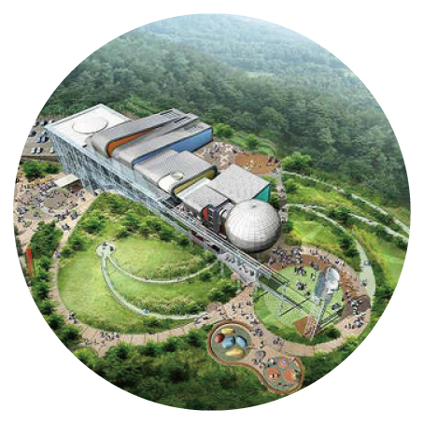
The Y’s Men International 5th Korea Area Convention
Tour Course - Changwon
Jinhae Marine Park
Changdong Art Village
Paryong Moutain Stone Tower
Dot-island Marine Park
Metasequoia Tree Street
Chanwon Science Center

Slide 8
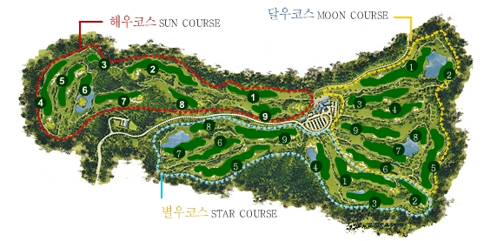
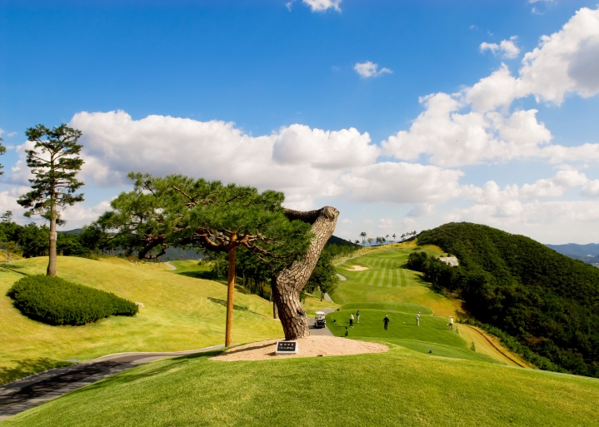



The Y’s Men International 5th Korea Area Convention
Tour Course
Jeongsan Country Club

Slide 9

The Y’s Men International
5th Korea Area Convention

